Slide 1
Research and GDPR: 1 year later
Prof. Dr. Patrick Cras
Dept of Neurology & Ethics Committee
Antwerp University Hospital
Research Club, 5th of June 2019

Slide 2
Life before and after the GDPR

Slide 3
Life before and after the GDPR
9

Slide 4
GDPR research principles self-evident?
Processing should be lawful, fair and transparent to the data subject (lawfulness, fairness and transparency)
Collection for specified, explicit and legitimate purposes and not processed in a manner that is incompatible with those purposes (purpose limitation)
Data should be adequate, relevant and limited to what is necessary for the processing purpose (data minimisation)
Data should be accurate, kept up to date and inaccurate data should be erased or rectified without delay (accuracy)
Data should be kept for no longer than necessary to fulfil the purpose, with some exceptions for archiving and research (storage limitation)
Data should be kept secure and protecting against accidental or illegal loss or access (integrity and confidentiality).
Notes:
specified, explicit and legitimate purposes and not further processed in a manner that is incompatible with those purposes – but Article 89 exemption for scientific research
adequate, relevant and limited to what is necessary
accurate and, where necessary, kept up to date
kept in a form which permits identification of data subjects for no longer than is necessary for the purposes for which the personal data are processed – but again article 89 exemption
processed in a manner that ensures appropriate security of the personal data
controller shall be responsible for, and be able to demonstrate compliance

Slide 5
What has changed in 2019?
Numerous publications and symposia
  23rd of May 2018 – Research Club
  24th of May 2018 - LOK
  18th of October 2018 – ACRP
  7th of November 2018 – hospital staff
  30th of March 2019 - Royal Academy of Medicine
  23rd of April 2019 - Icuro
National law has further defined research exemptions
Data processing in research is performed on legitimate base of ‘public interest’, then ‘scientific’ interest and in last instance based on ‘informed consent’
Code of conduct wrt data processing – work in progress

Slide 6











GDPR en de ziekenhuizen – Frank Robben
GDPR en wetenschappelijk onderzoek in het ZOL – Joke Vanlangenaker
De verzoening tussen privacybescherming en wetenschappelijk onderzoek in een universitair ziekenhuis – Griet Verhenneman
Privacybescherming en research – An Vyverman
Knelpunten rond privacybescherming – Audrey van Scharen
Het belang van vertrouwen – Tom Balthazar
Hergebruik van klinische data – Evelien Delbeke
How do sponsors of clinical research on medicines guarantee the protection of privacy – Pharma.be – Nathalie Lambot & Charlotte Weyne

Slide 7
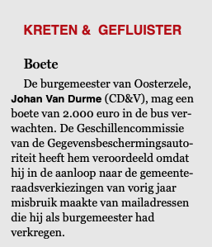
What has changed in 2019?
De Standaard, 6 juni 2019
And last but not least, pharma sponsors do not accept your CV with a birth date anymore

Slide 8
Investigators and ethics committees before and after the GDPR
Data security breaches will not be solved by GDPR
Organizations will have to develop methods and procedures in order to improve data security
Increased transparency for research participants
23rd of May 2018

Slide 9
Investigators and ethics committees before and after the GDPR
Data security breaches not solved by GDPR
National law provides research exemptions
Organizations have developed methods and procedures in order to improve data security
Increased transparency for research participants
Research support and data integrity
5th of June 2019

Slide 10
Vocabulary of GDPR
Personal data (‘persoonsgegevens’) = participant data
Controller (‘verwerkingsverantwoordelijke’): determines the purposes, conditions and means of the processing of personal data = principal investigator
Processor (‘verwerker’): processes personal data on behalf of the controller = investigator
Data protection officer (DPO) (‘Functionaris voor gegevensbescherming’) = newly appointed
Data protection authority (‘Gegevensbeschermingsautoriteit’) = exists
Data protection impact assessment = DPO, researcher, EC?
Legitimate interest (‘rechtmatig belang’) = research
Anonymized versus pseudonymized =coded
Notes:
‘Gegevensbeschermingsautoriteit’) wet van 3 december 2017

Slide 11
Terminologie?
‘Rechtmatige’ versus ‘gerechtvaardigde’ versus ‘rechtvaardige’ verwerking?
Maar geen consistente woordkeuze…
‘legitimate’ versus ‘justified’ versus ‘equitable’
VLIR gedragscode gegevensverwerking 2019

Slide 12
Verwerkingsverantwoordelijke = instelling, weliswaar gedeeld met onderzoeker
Gezamenlijke verwerkingsverantwoordelijken
Onderzoek, betrokkene, (gevoelige) persoonsgegevens, genetische, gezondheids-, biometrische gegevens, gepsuedonimiseerd, anoniem, kwetsbaar, …
Functionaris voor gegevensbescherming = persoon die intern aangesteld is als toezichthouder op de verwerking van persoonsgegevens
Zelfverantwoordingsplicht = aantonen verantwoordelijkheid om de verwerking op een rechtmatige en veilige manier te laten gebeuren
VLIR gedragscode gegevensverwerking 2019

Slide 13
Privacy by design => onderzoekersplicht
Een belangrijk principe is “privacy by design”, dit wilt zeggen dat de onderzoekers privacy bevorderende maatregelen nemen bij de opzet van het onderzoek in functie van het specifieke onderzoek. Bij het design van het onderzoek is het belangrijk om de verzameling en de verwerking van persoonsgegevens grondig te overwegen en te beschrijven. De onderzoekers dienen hierbij aan de volgende zaken te denken:
Data minimalisatie
Rechtsbasis voor de rechtmatige verwerking
Vaststellen van verantwoordelijkheden
Het invullen van het register voor verwerkingsactiviteiten
De Gegevensbeschermingseffectbeoordeling (GEB, DPIA, in voorkomend geval)
Passende organisatorische en technische maatregelen
VLIR gedragscode gegevensverwerking 2019

Slide 14
Protocol writing will change…
Introduction
Scientific rationale
Hypothesis
Methodology
Statistics & sample size
Ethics
Section on data collection and processing, secondary use
Data Protection Impact Assessment
Publication strategy
Timelines

Slide 15

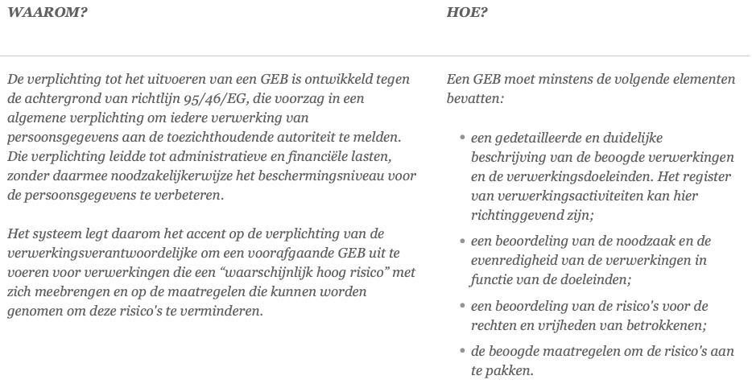
DPIA of GEB

Slide 16
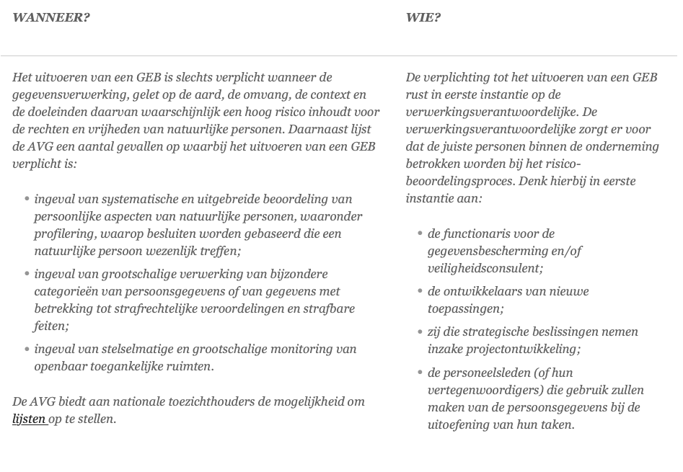
DPIA of GEB

Slide 17
Data minimalisatie
Enkel die persoonsgegevens die noodzakelijk zijn voor het bereiken van de doelstellingen
Anoniem voorkeur boven gepseudonimiseerd
Verder geen goede definitie…
Spanning tussen data minimalisatie, nauwkeurigheid, wetenschappelijke correctheid
Anonimisatie-technieken divers en afhankelijk van ICT-mogelijkheden
Principe van goede trouw, beroepsgeheim, verantwoord wetenschappelijk gedrag (“RCR”)

Slide 18
The color of your skin…

Slide 19
Rechtsgrond voor verwerking
Hierarchie in rechtsgrond… in die volgorde…
-algemeen belang
-rechtmatig belang
-geïnformeerde toestemming
En andere mogelijkheden…
-op basis van een wettelijke verplichting
-op basis van een contractuele overeenkomst
VLIR gedragscode gegevensverwerking 2019
European Data Protection Board (EDPB) in haar advies 3/2019

Slide 20
Een belangrijke ‘mindshift’…
“Er mag echter niet uit het oog worden verloren dat ook als aan de voorwaarden voor een geïnformeerde toestemming in het kader van de verordening inzake klinische proeven wordt voldaan, een situatie waarin duidelijk sprake is van een onevenwichtige machtsverhouding tussen de deelnemer en de opdrachtgever/onderzoeker inhoudt dat de toestemming niet „vrijelijk gegeven” is in de zin van de AVG. Het Comité is bijvoorbeeld van mening dat dit het geval is wanneer een deelnemer niet in goede gezondheid verkeert, wanneer deelnemers tot een economisch of sociaal achtergestelde groep behoren of wanneer zij zich in een situatie van institutionele of hiërarchische afhankelijkheid bevinden. Daarom, en zoals uitgelegd in de richtsnoeren inzake toestemming van de Groep artikel 29, is toestemming in de meeste gevallen niet de passende rechtsgrondslag, en moeten andere rechtsgrondslagen dan toestemming worden ingeroepen (zie hieronder alternatieve rechtsgrondslagen).””
VLIR gedragscode gegevensverwerking 2019
European Data Protection Board (EDPB) in haar advies 3/2019

Slide 21
Algemeen belang
“Wanneer het onderzoek verricht wordt op basis van door de overheid gefinancierde middelen (zoals door het FWO, het BOF, H2020,…) is dit een indicatie dat het onderzoek wordt gevoerd in het algemeen belang. “
passende technische en organisatorische maatregelen treffen om de inachtneming van het ‘beginsel van minimale gegevensverwerking’ te garanderen
VLIR gedragscode gegevensverwerking 2019

Slide 22
Permitted processing data for research
data subject has given consent to the processing of his or her personal data for one or more specific purposes
processing is necessary for the performance of a contract to which the data subject is party or in order to take steps at the request of the data subject prior to entering into a contract
processing is necessary for compliance with a legal obligation to which the controller is subject
processing is necessary in order to protect the vital interests of the data subject or of another natural person
processing is necessary for the performance of a task carried out in the public interest or in the exercise of official authority vested in the controller
processing is necessary for the purposes of the legitimate interests pursued by the controller or by a third party, except where such interests are overridden by the interests or fundamental rights and freedoms of the data subject
23rd of May 2018

Slide 23
Permitted processing data for research
data subject has given consent to the processing of his or her personal data for one or more specific purposes
processing is necessary for the performance of a contract to which the data subject is party or in order to take steps at the request of the data subject prior to entering into a contract
processing is necessary for compliance with a legal obligation to which the controller is subject
processing is necessary in order to protect the vital interests of the data subject or of another natural person
processing is necessary for the performance of a task carried out in the public interest or in the exercise of official authority vested in the controller
processing is necessary for the purposes of the legitimate interests pursued by the controller or by a third party, except where such interests are overridden by the interests or fundamental rights and freedoms of the data subject
5th of June 2019

Slide 24
Research as a legitimate interest
Controllers should take into account “the reasonable expectations of data subjects based on their relationship with the controller”
Existence of a legitimate interest requires a “careful assessment” of whether there is “a relevant and appropriate relationship” and “whether a data subject can reasonably expect at the time and in the context of the collection of the personal data that processing for that purpose may take place” (Recital 47)
Highly fact- and context-specific analysis

Slide 25
Adaptation of document templates
Contracts between research organizations, investigators and third parties
Primary and future use described in detail
Protocols should include sections on GDPR compliant data storage and handling
Timing of pseudo- or anonymization, archiving
Informed consent documents
Describing why limitation of GDPR rights
Future/secondary use of data and/or samples
Publication and consultation

Slide 26
Informed consent template changes
a) The right to be informed: who will be processing their data and for what reasons; added
b) The right of access: existed already
c) The right to rectification: existed already
d) The right to erasure: questionable in research (?)
e) The right to restrict processing: right to ‘block’ or suppress processing; questionable in research (?)
f) The right to data portability: obtain and reuse personal data for their own purposes; not applicable to research
g) The right to object: Individuals have the right to object to processing based on legitimate interests, direct marketing, processing for purposes of scientific research and statistics; patients informed about secondary use (!)
h) Rights in relation to automated decision making and profiling: not applicable to research
23rd of May 2018

Slide 27
Informed consent template changes
a) The right to be informed: who will be processing their data and for what reasons; added
b) The right of access: existed already
c) The right to rectification: existed already
d) The right to erasure: research exemption
e) The right to restrict processing: right to ‘block’ or suppress processing; research exemption
f) The right to data portability: obtain and reuse personal data for their own purposes; not applicable to research
g) The right to object: Individuals have the right to object to processing based on legitimate interests, direct marketing, processing for purposes of scientific research and statistics; in some organizations patients informed about secondary use (!)
h) Rights in relation to automated decision making and profiling: not applicable to research
5th of June 2019

Slide 28
Informed consent strenghtened
New templates !
Notes:
Recital 33 therefore allows data subjects ‘to give their consent to certain areas of scientific research when in keeping with recognised ethical standards for scientific research. Data subjects should have the opportunity to give their consent only to certain areas of research or parts of research projects to the extent allowed by the intended purpose.’
Plain language. Any information and communications regarding data processing must be “easily accessible and easy to understand,” and “clear and plain language [must] be used.” (Recital 39) Similarly, consent provisions cannot be “buried” in another, longer document. If consent is given in the context of a document that also addresses other matters, the consent portion of the document must be “clearly distinguishable from the other matters, in an intelligible and easily accessible form, using clear and plain language.” (Article 7(2))
Affirmative act. Consent must be “freely given, specific, informed and unambiguous.” (Recital 32) The data subject must signify his or her consent through an affirmative act, such as by signing a written document, checking a box on a website, or other action that clearly demonstrates the subject’s intent to agree to the data processing. It is not appropriate to set up an “opt-out” system whereby the data subject has consented to the data processing unless he or she takes an affirmative action to show a lack of consent, as “[s]ilence, pre-ticked boxes, or inactivity” does not constitute consent.
Documentation. Whenever data processing is based on the consent of the data subject, the controller must be able to demonstrate that such consent was valid and documented. (Article 7(1))
Withdrawal of consent. A data subject may withdraw his or her consent to data processing at any time. (Article 7(3)) Data subjects must be informed at the time they give consent that such withdrawal will not retroactively invalidate any data processing that took place in accordance with the original consent. Data processors and controllers must make it as easy to withdraw consent as it is to give consent; for example, if a person can give consent to data processing by clicking a checkbox on a website, withdrawal of consent cannot require mailing a paper letter to a post office address.
Invalid consent. Consent is not valid if it is not freely given. For example, “if the data subject has no genuine or free choice or is unable to refuse or withdraw consent without detriment,” consent is not freely given and is thus presumed to be invalid. (Recital 42) Similarly, in situations in which the controller’s performance of a contractual obligation or provision of a service is contingent upon the data subject’s granting of consent to process his or her personal data, consent is presumed to be invalid if data processing is not necessary for the controller to meet its obligations. (Recital 43; Article 7(4))
Consent for use of minors’ data. “Information society services,” which encompass online services such as social media sites, cannot be provided to minors under the age of sixteen without parental consent. (Article 8) (Note that individual Member States may establish laws permitting minors as young as thirteen to access information society services without parental consent.)
Consent for processing special categories of personal data. The processing of sensitive personal data, which is defined as data that reveals the subject’s racial or ethnic origin, political opinions, religious or philosophical beliefs, or trade union membership, as well as genetic data, biometric data used for identification purposes, health information, and data concerning a person’s sex life or sexual orientation, is prohibited unless the individual has given explicit consent to the processing. (Article 9) Some Member States may prohibit the processing of such data in every situation, regardless of whether the data subject consents.
Limitations on data collection and processing. Data processors and controllers may only collect the personal data needed for the purpose of the data processing activity, and may only retain personal data for the time period needed to carry out the purpose of the data processing. (Recital 39) Personal data may not be retained in perpetuity, nor may personal data be used or processed for any purpose other than that for which the individual gave consent, unless additional consent is obtained or another, legitimate justification for the processing is demonstrated (such as compliance with legal requirements).

Slide 29
Informed consent strenghtened
New templates !
Notes:
Recital 33 therefore allows data subjects ‘to give their consent to certain areas of scientific research when in keeping with recognised ethical standards for scientific research. Data subjects should have the opportunity to give their consent only to certain areas of research or parts of research projects to the extent allowed by the intended purpose.’
Plain language. Any information and communications regarding data processing must be “easily accessible and easy to understand,” and “clear and plain language [must] be used.” (Recital 39) Similarly, consent provisions cannot be “buried” in another, longer document. If consent is given in the context of a document that also addresses other matters, the consent portion of the document must be “clearly distinguishable from the other matters, in an intelligible and easily accessible form, using clear and plain language.” (Article 7(2))
Affirmative act. Consent must be “freely given, specific, informed and unambiguous.” (Recital 32) The data subject must signify his or her consent through an affirmative act, such as by signing a written document, checking a box on a website, or other action that clearly demonstrates the subject’s intent to agree to the data processing. It is not appropriate to set up an “opt-out” system whereby the data subject has consented to the data processing unless he or she takes an affirmative action to show a lack of consent, as “[s]ilence, pre-ticked boxes, or inactivity” does not constitute consent.
Documentation. Whenever data processing is based on the consent of the data subject, the controller must be able to demonstrate that such consent was valid and documented. (Article 7(1))
Withdrawal of consent. A data subject may withdraw his or her consent to data processing at any time. (Article 7(3)) Data subjects must be informed at the time they give consent that such withdrawal will not retroactively invalidate any data processing that took place in accordance with the original consent. Data processors and controllers must make it as easy to withdraw consent as it is to give consent; for example, if a person can give consent to data processing by clicking a checkbox on a website, withdrawal of consent cannot require mailing a paper letter to a post office address.
Invalid consent. Consent is not valid if it is not freely given. For example, “if the data subject has no genuine or free choice or is unable to refuse or withdraw consent without detriment,” consent is not freely given and is thus presumed to be invalid. (Recital 42) Similarly, in situations in which the controller’s performance of a contractual obligation or provision of a service is contingent upon the data subject’s granting of consent to process his or her personal data, consent is presumed to be invalid if data processing is not necessary for the controller to meet its obligations. (Recital 43; Article 7(4))
Consent for use of minors’ data. “Information society services,” which encompass online services such as social media sites, cannot be provided to minors under the age of sixteen without parental consent. (Article 8) (Note that individual Member States may establish laws permitting minors as young as thirteen to access information society services without parental consent.)
Consent for processing special categories of personal data. The processing of sensitive personal data, which is defined as data that reveals the subject’s racial or ethnic origin, political opinions, religious or philosophical beliefs, or trade union membership, as well as genetic data, biometric data used for identification purposes, health information, and data concerning a person’s sex life or sexual orientation, is prohibited unless the individual has given explicit consent to the processing. (Article 9) Some Member States may prohibit the processing of such data in every situation, regardless of whether the data subject consents.
Limitations on data collection and processing. Data processors and controllers may only collect the personal data needed for the purpose of the data processing activity, and may only retain personal data for the time period needed to carry out the purpose of the data processing. (Recital 39) Personal data may not be retained in perpetuity, nor may personal data be used or processed for any purpose other than that for which the individual gave consent, unless additional consent is obtained or another, legitimate justification for the processing is demonstrated (such as compliance with legal requirements).

Slide 30
Rechten respondenten tijdens onderzoek
Naam onderzoeker, naam van de DPO of het uniek meldpunt
In eerste instantie onderzoeker contacteren bij vragen of voor het uitoefenen van hun rechten
Bij problemen kan DPO of uniek meldpunt gecontacteerd worden
Indien het onderzoek vergt dat het inzagerecht wordt beperkt zal de betrokkene die er om vraagt daarover ingelicht worden samen met zijn recht om daarover een klacht in te dienen bij de toezichthoudende autoriteit
VLIR gedragscode gegevensverwerking 2019

Slide 31
Rechten respondenten tijdens onderzoek
Rechtmatig verzamelde gegevens kunnen niet uit een lopend onderzoek gewist worden zonder dat onderzoek schade toe te brengen
Evenmin kan er een beperking op de verwerking worden ingesteld die raakt aan de wetenschappelijke methode
Recht om manifest foutieve gegevens te doen verbeteren
Geldt echter niet voor gegevens die een oordeelselement bevatten of de uitkomst zijn van objectief uitgevoerde metingen of testen
VLIR gedragscode gegevensverwerking 2019

Slide 32
Right to erasure not applicable…
“het verwerken van persoonsgegevens plaats vindt met algemeen belang als rechtsgrond en bijgevolg het recht op vergetelheid niet kan worden ingeroepen”
“Deelnemers blijven te allen tijde vrij om hun deelname aan een onderzoek stop te zetten, evenwel zonder te kunnen eisen dat reeds verzamelde persoonsgegevens gewist of niet langer verwerkt worden. “
VLIR gedragscode gegevensverwerking 2019
European Data Protection Board (EDPB) in haar advies 3/2019

Slide 33
Data storage and handling
Data storage for extended –possibly indefinite- period
Requirement to undertake periodic review
Creates a substantial burden for research institutions
Difficult to predict future use or need
Notifying research participants would create disproportionate burden – definition of ‘disproportionate’?
Impact assessment of data operations presenting
specific risks troublesome for investigators
Data transfer outside EU

Slide 34
Register voor verwerkingsactiviteiten
“Voor de concrete uitvoering van het onderzoek worden binnen onderzoekgroepen duidelijke afspraken gemaakt over wie verantwoordelijk is voor de pseudonimisering, wie verantwoordelijk is voor het aanvullen van het register, wie toegang heeft tot de sleutel, wie toegang heeft tot de ruwe gegevens/gepseudonimiseerde gegevens, ….
Deze afspraken worden gedocumenteerd in het register voor verwerkingsactiviteiten. “
VLIR gedragscode gegevensverwerking 2019
European Data Protection Board (EDPB) in haar advies 3/2019

Slide 35
Register voor verwerkingsactiviteiten
Voor elke verwerkingsactiviteit dient de onderzoeker in het AVG register minstens de volgende informatie te documenteren:
De titel, beschrijving en doelstellingen van het onderzoek
Primaire of secundaire verwerking van persoonsgegevens
Bij secundaire verwerking: of de betrokkenen geïnformeerd kunnen worden over de verwerking
De categorieën van persoonsgegevens die verzameld worden
De categorieën van betrokkenen waarover persoonsgegevens verzameld worden
Overzicht van de technische en organisatorische maatregelen genomen worden om de privacy en de rechten van de betrokkenen te waarborgen en hoe lang de gegevens bewaard zullen worden
De rechten van de betrokkenen en of hier uitzonderingen op voorzien moeten worden
De rechtsgrond van de verwerking
met wie de data gedeeld worden (binnen of buiten de EER)
Checklist om na te gaan of er een extra risico-analyse (GEB) uitgevoerd moet worden
VLIR gedragscode gegevensverwerking 2019

Slide 36
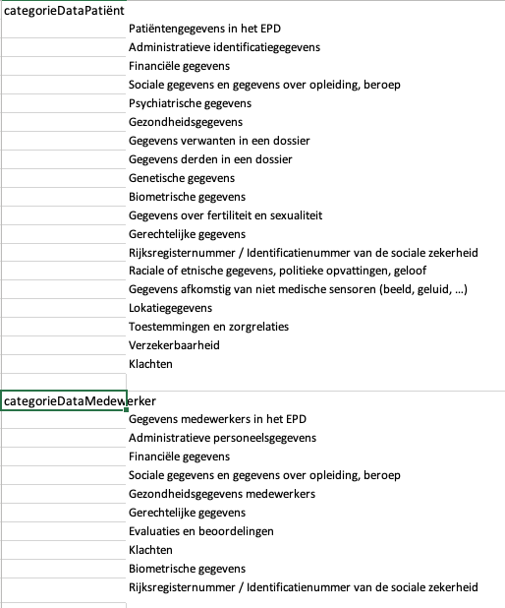
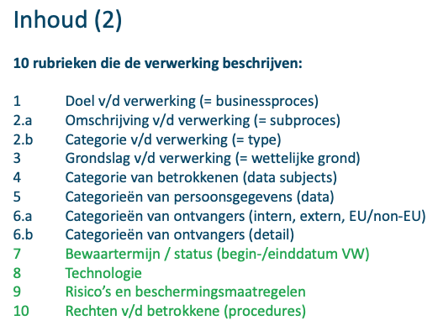
Work in progress…
Vb. UA
Vb. UZA excel 189 lijnen

Slide 37
Gegevensbeschermingseffectenbeoordeling
DPIA = data protection impact assessment
“Elke instelling neemt in haar register 12 criteria op
indien een verwerking voldoet aan twee of meer criteria
dient de onderzoeker 3 bijkomende vragen te beantwoorden
ad hoc procedure van de eigen instelling
“Elke instelling werkt deze ad hoc procedure uit en maakt deze kenbaar aan de onderzoekers. Deze kan bijvoorbeeld inhouden dat de DPO het voorstel individueel bekijkt en er advies op geeft. De criteria zijn terug te vinden in de FAQ “
VLIR gedragscode gegevensverwerking 2019
https://researchsupport.admin.ox.ac.uk/policy/data/checklist

Slide 38
Informatieveiligheidsbeleid en de instelling
internationaal erkende standaarden (bv. ISO 270001, NIST richtlijnen,…)
aanbieden van producten en diensten die door onderzoekers ingezet kunnen worden om de privacy van de betrokkenen te waarborgen
kenbaar maken aan onderzoekers en gebruik ervan faciliteren
VLIR gedragscode gegevensverwerking 2019

Slide 39
Specifications/derogations in national law
19 JUL 2018 – 286 articles, 155 pages
Replacing Royal Decree 13 FEB 2001 ‘privacy law’
‘Controller’ and other definitions further defined
Art. 15 access, art. 16 rectification, art. 18 processing restriction, art. 21 objection - limited in favor of research
Health care (research) data vs secondary use (art. 194-197)– “broad consent” with limitations and transparency
Code of conduct (art. 40 GDPR) – VLIR, Royal Academy of Medicine, ICURO
Icuro, Balthazar, 2018
Notes:
There may be exemptions from the requirement to stop processing, for example where the processing is for the establishment, exercise or defence of legal claims.
h) Rights in relation to automated decision making and profiling
Individuals are given various safeguards against the risk that a potentially damaging decision is taken automatically. Generally, individuals will be entitled to
obtain human intervention express their point of view, and
obtain an explanation of the decision and challenge it.

Slide 40
Difficulty in identifying research purposes in advance
Providing up front notice about research at the point of collection poses a challenge for researchers
Data mining techniques often search for correlations within data sets without the baseline of a specific test hypothesis
Researcher may not know the scope of his research until after the data is collected and used
Data subjects should be able to “consent only to certain areas of research or parts of research projects to the extent allowed by the intended purpose.”

Slide 41
Essential elements of compliance
technical and organizational measures: internal data protection policies; being reinforced
relevant documentation on processing activities; being implemented, burden is on investigators
large scale processing of special categories of data appoint a Data Protection Officer (DPO); contact added to ICF
implement measures that meet the principles of data protection by design and data protection by default
Data minimization; TBD
Pseudonymisation; new terminology
Transparency
monitor processing, creating and improving security features on an ongoing basis; ethics committees, CTC and DPO
data protection impact assessments where appropriate; ethics committees, CTC and DPO
Notes:
internal data protection policies such as staff training, internal audits of processing activities, and reviews of internal policies
Data minimalization is a new concept, could have important

Slide 42
Will GDPR approach continue to work?
Biomedical research ever more data intensive
“Big data” sources: EHR accessible to patients and ‘apps’, clinical trial data, biobanking and genomics/-omics
Database cross linking, face, voice and other biometric recognition and profiling will render privacy illusive
Video registration, photographing and functional neuro-imaging both static and dynamic
Face recognition and ‘emotional’ face recognition
Rare diseases and center identification, cross referencing of databases
Notes:
In Shenzeng China, face recognizing cameras are used in order to identify people negating red traffic lights

Slide 43
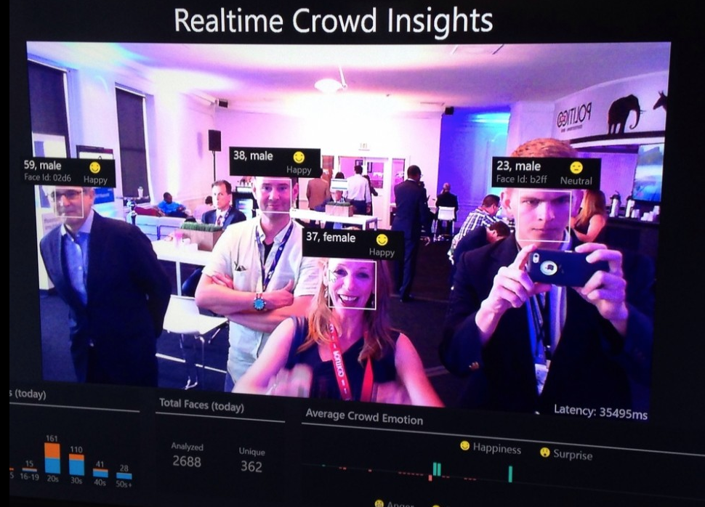
Face and emotion recognition

Slide 44
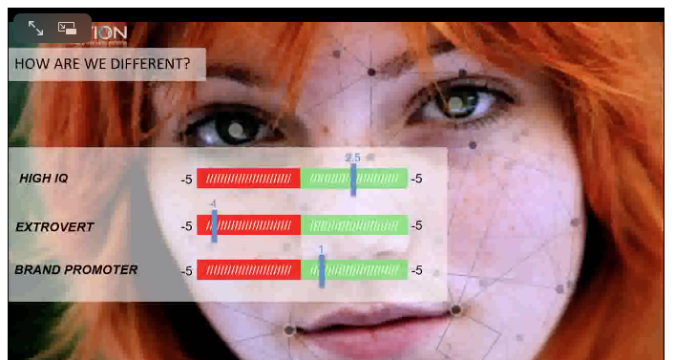
Faception claims even more…personality traits

Slide 45
Will GDPR approach continue to work?
Biomedical research ever more data intensive
“Big data” sources: EHR accessible to patients and ‘apps’, clinical trial data, biobanking and genomics/-omics
Database cross linking, face, voice and other biometric recognition and profiling will render privacy illusive
Video registration, photographing and functional neuro-imaging both static and dynamic
Face recognition and ‘emotional’ face recognition
Rare diseases and center identification, cross referencing of databases
GDPR framework will need continuous updating…
Notes:
In Shenzeng China, face recognizing cameras are used in order to identify people negating red traffic lights

Slide 46
GDPR facilitates research
Research occupies a privileged position within the Regulation - “broad” definition of research
Research has a clear legitimate base of ‘public’ interest
GDPR’s research exemptions and ‘legitimate interest’ defined by national law and guidelines
Organizations are currently implementing appropriate safeguards
Ethics committees pivotal intermediate role between organizations, investigators, and research participants
Scientific community has a moral obligation to improve transparency on use of health care data
Notes:
Met exemption bedoelt men de vermindering van de rechten van de data subjects (bvb recht om vergeten te worden)

